Slide 1
DO NOW
What do all of the waves in the electromagnetic spectrum have in common?
Their wavelength
Their frequency
Their speed
Their energy
2. What is the only type of wave that can be seen by humans?

Slide 2
Review
*Which wave has more energy, x-ray or visible light? How do you know this?
*Which wave has higher frequency, ultraviolet or microwave? How do you know this?

Slide 3
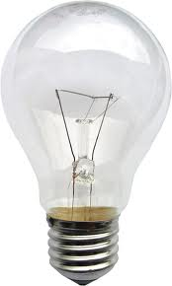
Visible Light
Visible light is the only EM wave that humans can see.
How is it created?
The sun can provide it naturally.
Humans can make it artificially with light bulbs.

Slide 4
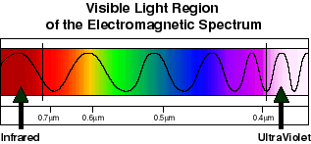
Visible Light and Color
Visible light is composed of 7 colors.
The 7 colors that make up visible light are:
Red, Orange, Yellow, Blue, Green, Indigo, Violet (ROYGBIV)
They go from longest wavelength to shortest wavelength.

Slide 5
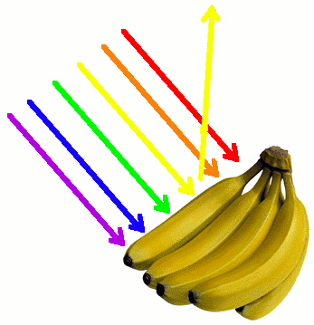
Seeing One Color
When we see just one color, we see the color that is reflected back to our eyes.
The other colors are absorbed by that object.
When these 7 colors are combined, we see white light!
When all of the colors are absorbed, we see black
For example:
Shirt
Shoes

Slide 6
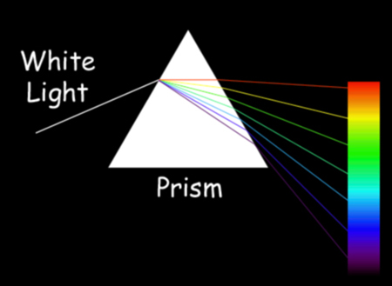
Seeing All 7 Colors
When visible light is refracted (bent), we see all 7 colors in order (ROYGBIV)

Slide 7
STUDYJAMS!
Notes:
www.studyjams.com- video on Visible Light

Slide 8
Individual White Boards!
1. What color is your desk?
What colors are reflected
What colors are absorbed
2. What color is the MVP bulletin board?
What colors are being reflected?
What colors are being absorbed?
3. What color are the dry erase boards?
What colors are being reflected?
What colors are being absorbed?
4. How can we see all the colors at once in nature?

Slide 9
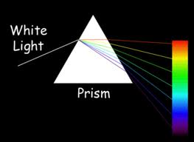
Individual White Boards!
5. When white light is refracted, what will the order of the colors be?

Slide 10
Individual White Boards
6. Which color has a longer wavelength, orange or blue?
7. Which color has a higher frequency, yellow or violet?

Slide 11
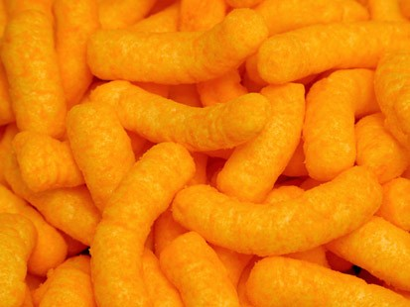
Individual White Boards
8. These Cheetos are orange because…

Slide 12
Independent Practice
Answer the questions on the worksheet
Raise your hand if you are stuck!
This is homework if not finished!

Slide 13
COOL DOWN
The 7 colors of visible light are arranged according to their
Brightness
Wavelength
Speed
Color
2. List the colors of the visible light spectrum in order from longest wavelength to shortest wavelength.
3. Which color has a higher frequency, orange or blue?

Slide 14
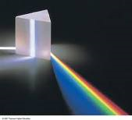
COOL DOWN
4. A leaf is green. What does that tell you about the light that is being absorbed?
The light is a UV ray
The light is not a part of the light spectrum
All colors are reflected except green
All colors are absorbed except green
5. What color is an object that absorbs all of the colors of the light spectrum?
A rainbow
White
Black
Invisible

Slide 15
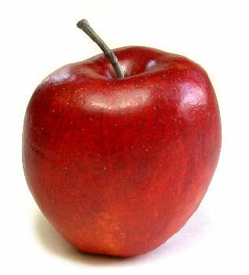
COOL DOWN
6. An apple is red because…

